Slide 1
Data Models (part 1) SI649
Eytan Adar
http://si649.cond.org + CTools

Slide 2
Last time…

Slide 3
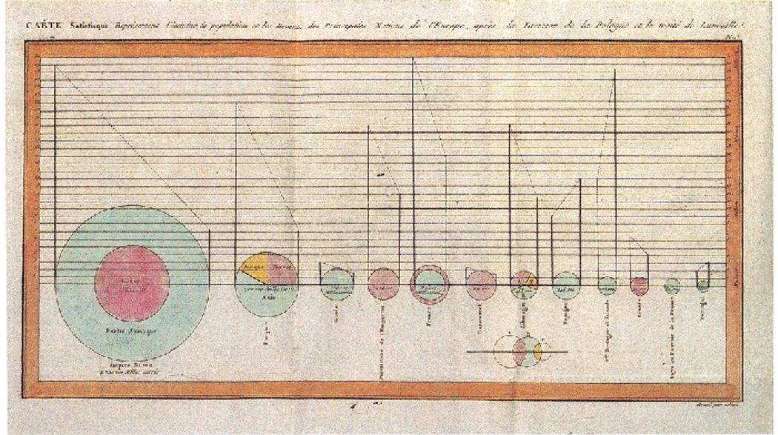
Some history: Playfair, 1786

Slide 4
Some examples…

Slide 5
Anscombe’s Quartet
I |  | II |  | III |  | IV
x | y | x | y | x | y | x | y
10.0 | 8.04 | 10.0 | 9.14 | 10.0 | 7.46 | 8.0 | 6.58
8.0 | 6.95 | 8.0 | 8.14 | 8.0 | 6.77 | 8.0 | 5.76
13.0 | 7.58 | 13.0 | 8.74 | 13.0 | 12.74 | 8.0 | 7.71
9.0 | 8.81 | 9.0 | 8.77 | 9.0 | 7.11 | 8.0 | 8.84
11.0 | 8.33 | 11.0 | 9.26 | 11.0 | 7.81 | 8.0 | 8.47
14.0 | 9.96 | 14.0 | 8.10 | 14.0 | 8.84 | 8.0 | 7.04
6.0 | 7.24 | 6.0 | 6.13 | 6.0 | 6.08 | 8.0 | 5.25
4.0 | 4.26 | 4.0 | 3.10 | 4.0 | 5.39 | 19.0 | 12.50
12.0 | 10.84 | 12.0 | 9.13 | 12.0 | 8.15 | 8.0 | 5.56
7.0 | 4.82 | 7.0 | 7.26 | 7.0 | 6.42 | 8.0 | 7.91
5.0 | 5.68 | 5.0 | 4.74 | 5.0 | 5.73 | 8.0 | 6.89
x mean = 9, x variance = 11,
y mean = 7.5, y variance = 4.12
Correlation = 0.816
Regression: y = 3 + .5x

Slide 6
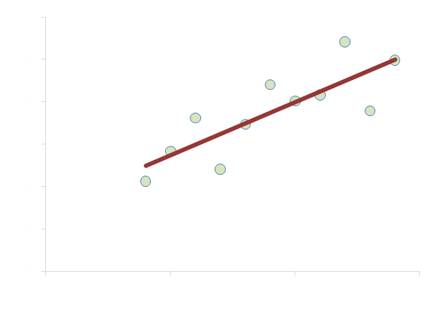
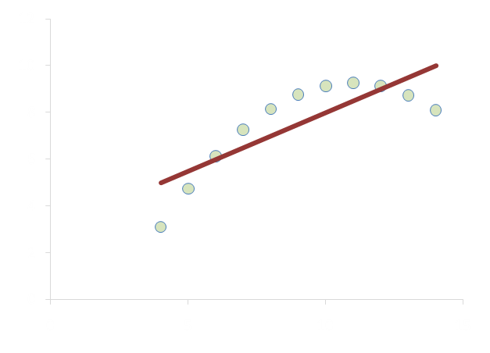
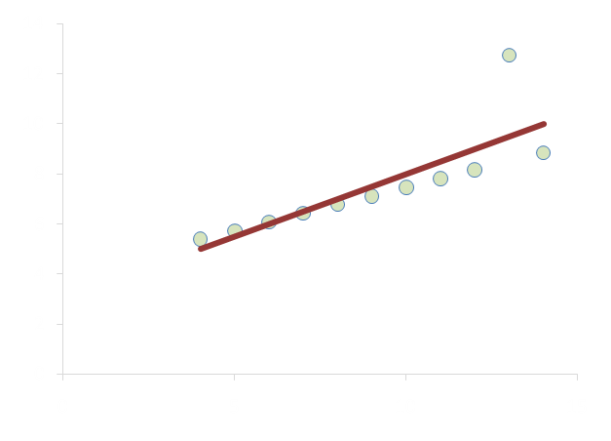
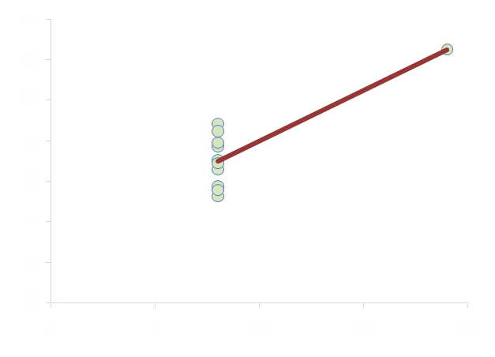

Slide 7
High level functions
Record
Analyze
Communicate
Inspire

Slide 8
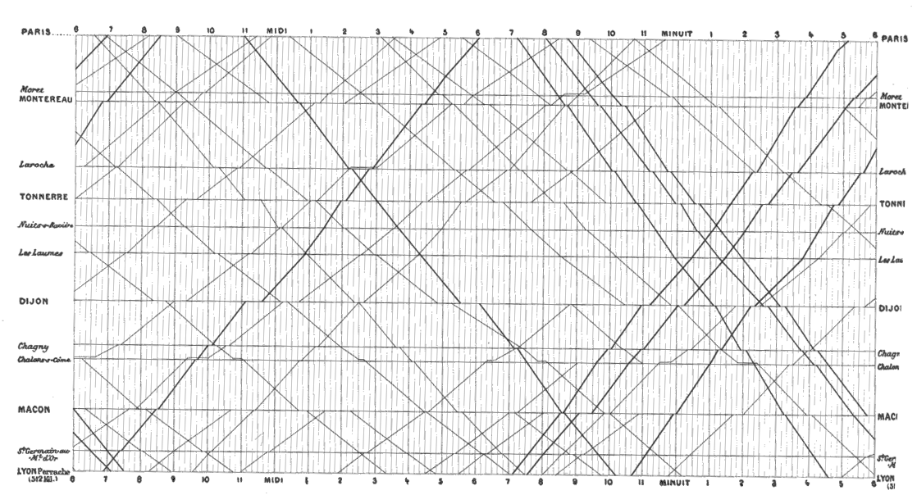
French Train Schedule, in Tufte 2001

Slide 9
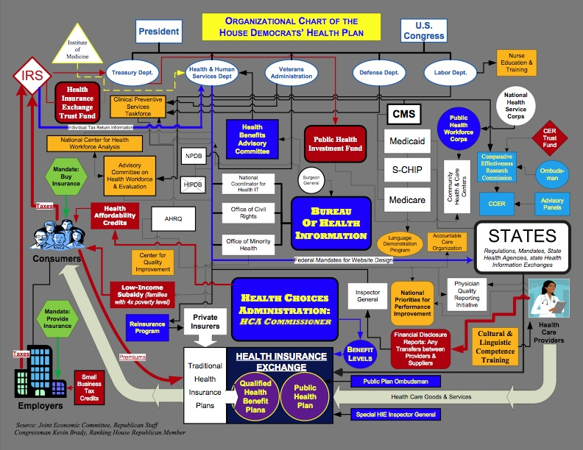

Slide 10
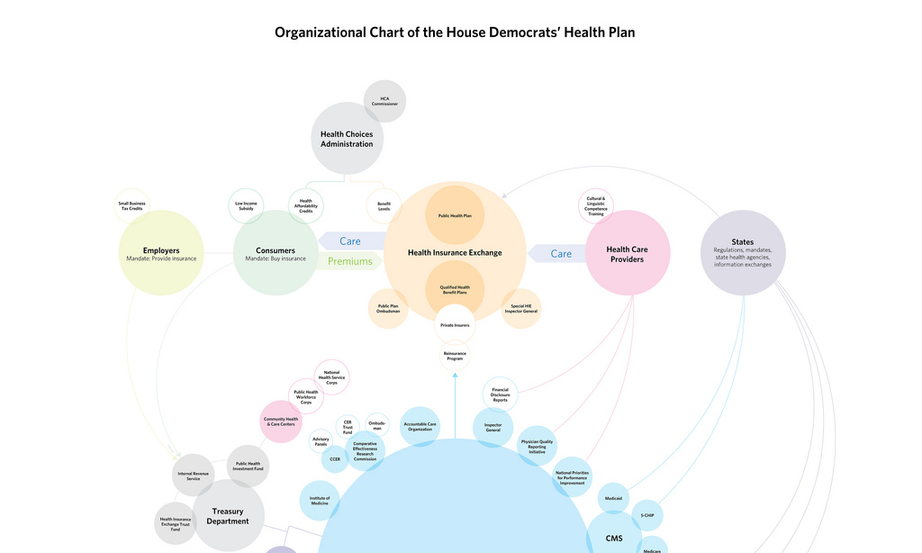
Do Not Fuck With Graphic Designers
Robert Palmer
http://www.flickr.com/photos/robertpalmer/3743826461/
See also: http://infosthetics.com/archives/2010/01/chart_wars_the_political_power_of_data_visualization.html

Slide 11
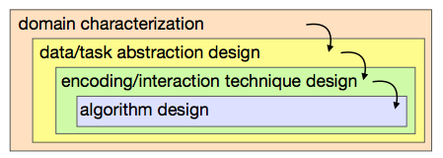
The skill we will develop
Identify the job, and job functions
Identify the visual comparisons that enable function
Identify the best visual encoding/idioms that support those comparisons
Identify the best way to implement

Slide 12
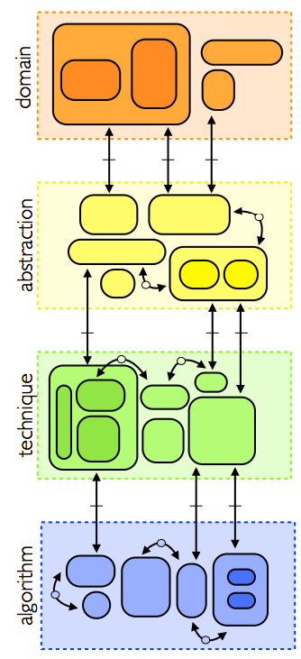
Munzner, 2009
Meyer et al., 2013

Slide 13
Meyer et al., 2013

Slide 14
Task
Data
Count
Abstract type
(nominal, ordinal, etc.)
Physical type
(int, float, etc.)
mapping
Visual encoding
Visual metaphor
Mark/Image
Count
Visual channel
Retinal Variables
Meyer et al., 2013

Slide 15
Today’s Topics
Data + Information
Images + Marks
Well designed encodings (part 1)

Slide 16
Data

Slide 17
Quick tour of data
Data models
Relational
Statistical
Cube
Taxonomies of Data
Attributes of Data

Slide 18
Data Models vs. Conceptual Models
Data Model
Conceptual Model
1D
1D
3D
Low level descriptions
Math: Sets with operations on them
Example: integers with + and × operators
Time
Temperature
Space
Mental constructions
Include semantics and support reasoning
But the line is fuzzy

Slide 19
Relational
Records are fixed length tuples
Relation is schema (metadata) and table of data (i.e., tuples)
Database is a collection of relations
Columns (attributes) have a domain (type)
string →
Integer →
Date →
Schema →
Employee ID | Name | Department | Salary | Date hired
525531 | Sally Jenkins | Engineering | 65000 | 1/2/2008
324234 | Bob Jones | IT | 50000 | 3/5/2009
231144 | Tim Smith | Engineering | 70000 | 5/9/1997
223423 | Jane Saget | HR | 55000 | 9/27/2005
Tuple →

Slide 20
Relational Algebra [codd]
Data transformed through SQL
Selection (SELECT)
Projection (WHERE)
Sorting (ORDER BY)
Aggregation (GROUP BY)
Set operations (UNION,…)
Join (INNER JOIN)

Slide 21
Statistical
Variables or measurements
Categories or factors or dimensions
Observations or cases
Month | Control | Placebo | 300mg | 450mg
March | 165 | 163 | 166 | 168
April | 162 | 159 | 161 | 163
May | 164 | 158 | 161 | 153
June | 162 | 161 | 158 | 160
July | 166 | 158 | 160 | 148
August | 163 | 158 | 157 | 150

Slide 22
Statistical Models
Generally trying to model systems
Independent versus Dependent
Example: y= f(x,a)
Dimensions: domain(x) × domain(a)
Measures: range(y)
Dimensions: discrete variables describing data (dates, categories, etc.) → indep. variables
Measures: values that can be aggregated → dependent variables
Notes:
Dependent → y changes based on independent variables
Dimensions → all the possible states of the independent variables
Measures → all the possible outcomes

Slide 23
Example
I have two drugs A and B that I can adjust (independent variables)
I can measure the impact on your white blood cells C (dependent variable)
C = f(A,B)
The possible dosage for A is 10,15 or 20 Mg
The possible dosage for B is 16 or 23 Mg
There are 6 possible combinations of A and B
domain
Your white blood cell count can range from 3.5 – 10.5 billion cells/L
measure
 | A=10 | A=15 | A=20
B=16
B=23
 | A=10 | A=15 | A=20
B=16 | 10,16 | 15,16 | 20,16
B=23 | 10,23 | 15,23 | 20,23
A=10 | A=15 | A=20
domain

Slide 24
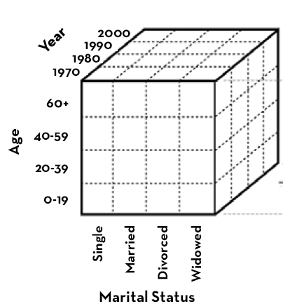
Cube
Adapted from Heer

Slide 25
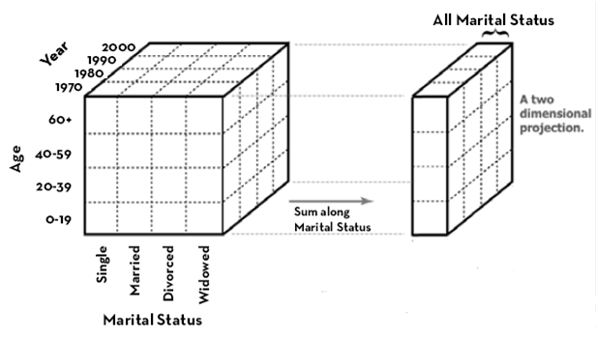
Dissecting the cube
Rolling-up: grouping along desired dimension
SELECT year, age, sum(people)
FROM census
GROUP BY year, age
Adapted from Heer

Slide 26
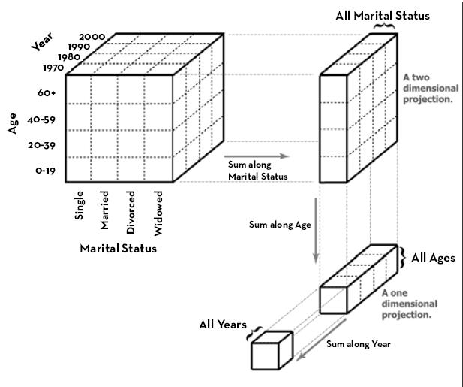
Cube
Adapted from Heer

Slide 27
Dissecting the cube
Drill-down: split into more dimensions
SELECT year, age, marital_status, sum(people)
FROM census
GROUP BY year, age, marital_status
Adapted from Heer

Slide 28
Cube
Roll Up →
← Drill Down
Adapted from Heer

